Slide 1
Hands On Machine Learning
Chapter 03. Classification
박용욱
qkrdyddnr@inha.edu
2024.09.10

Slide 2
INDEX
0. Machine Learning Preview
3.1 MNIST
3.2 Training a Binary classifier
3.3 Performance Measures
3.3.1 Confusion Matrix
3.3.2 Precision / Recall Trade-Off
3.3.3 PR, ROC Curve
3.3.4 AUC

Slide 3
Machine Learning Preview
Classification
Binary Classification
Cross Validataion
Training model
Linear Regression
Gradient Descent
F1-Score
Multiclass, Multilabel, Multioutput
Classification
Polynomial Regreesion
Overfitting, Underfitting
Lidge, Rasso
Logistic Regression, Softmax Regression
Support Vector Machines
Linear SVM Classification
Non Linear SVM Classification
SVM Regression
Decision Trees
Gini Impurity
Regression(Decision Trees)

Slide 4
Machine Learning Preview
Ensemble Learning and Random Forest
Dimensionality Reduction
Unsupervised Learning Techniques
Voting
Bagging and Pasting
Random Forest
Boosting (AdaBoost, Gradient Boosting)
Stacking
Projection - PCA
Manifold Learning - LLE
Kernel
Clustering
KMeans
DBSCAN
Gaussian Mixtures

Slide 5
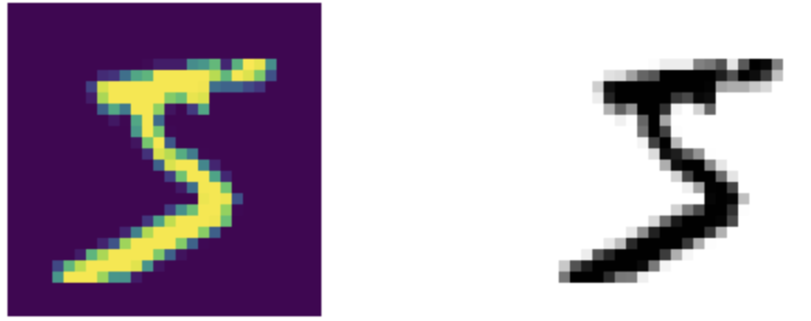
3.1 MNIST
==
!=

Slide 6
3.2 Training a Binary Classifier
1
1
9
9
0
0
2
8
2
8
7
7
5
5
6
6
3
4
3
4

Slide 7
3.3 Performance Measures
Train Test Split
Total dataset
Train Set
Test Set
K-Fold
Validation Set
Train Set
Train Set
Test Set
Train Set
Validation Set
Train Set
Test Set
Train Set
Train Set
Validation Set
Test Set

Slide 8
3.3 Performance Measures
Total dataset
Train Set
Test Set
A Class
B Class
Test Set
K-Fold
Validation Set
Train Set
Train Set
Test Set
A Class
B
A Class
B
A Class
B
Test Set
StratifiedKFold

Slide 9
3.3 Performance Measures
Validation Set
Train Set
Train Set
Test Set
Prediction : 1,0,1,0, … 0,1,1,0
Accuarcy : 95%
Target Value : 1,1,1,0, … 0,1,1,0
Train Set
Validation Set
Train Set
Test Set
0,0,0,0,…,1,1,0,1
Train Set
Train Set
Validation Set
Test Set
1,1,1,0,…,0,0,0,1
Cross_val_score

Slide 10
3.3 Performance Measures
Validation Set
Train Set
Train Set
Test Set
Prediction : 1,0,1,0, … 0,1,1,0
Train Set
Validation Set
Train Set
Test Set
0,0,0,0,…,1,1,0,1
Train Set
Train Set
Validation Set
Test Set
1,1,1,0,…,0,0,0,1
Validation Set
Validation Set
Validation Set
Prediction : 1,0,1,0, … 0,1,1,0
0,0,0,0,…,1,1,0,1
1,1,1,0,…,0,0,0,1
Cross_val_predict

Slide 11
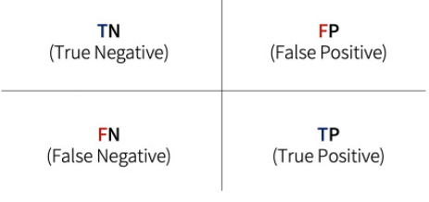
3.3.1 Confusion Matrix
1
1
This is not 5
This is 5
5
5
This is not 5
This is 5
If the model is successful in predicting, it's True or False
If the model predicted positively, positive or negative

Slide 12
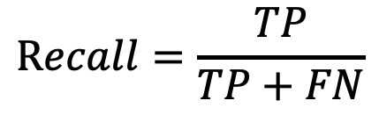
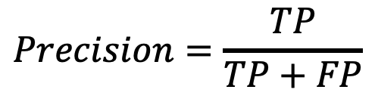
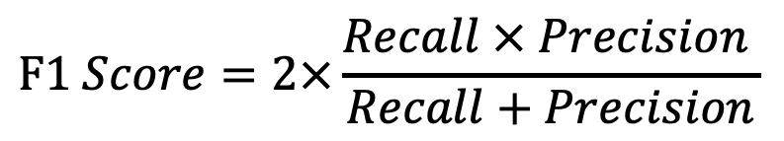
3.3.1 Confusion Matrix
$$Precision=\frac{TP}{TP+FP}$$
Does the model have less spam classification mail misdetection
$$Recall=\frac{TP}{TP+FN}$$
How many cancer patients does the model find
$$F1 Score=2×\frac{Recall × Precision }{Recall+Precision}$$
If the importance of precision and recall is similar, the F1 score can be used

Slide 13


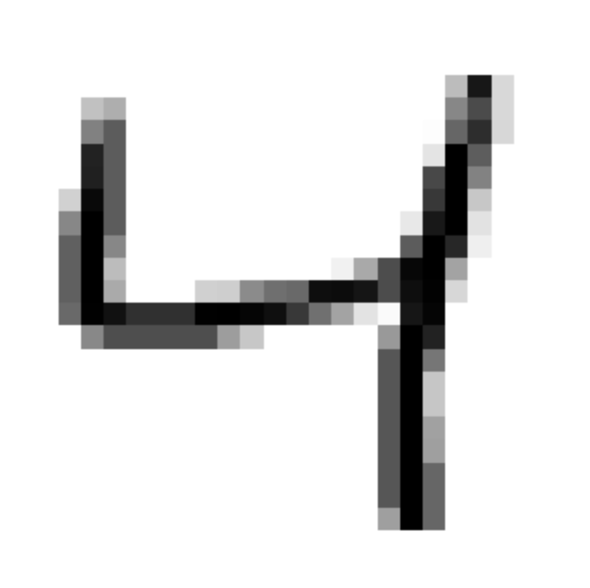








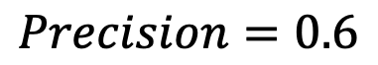
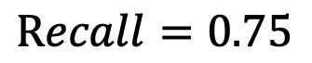
3.3.2 Precision / Recall Trade-Off
Decision Function
Predict to Negative
Predict to Positive
Increasing Recall
0
Generally Increasing Precision
$$Precision=0.6$$
$$Recall=0.75$$

Slide 14
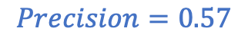
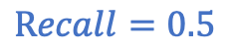
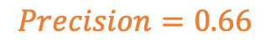
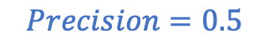
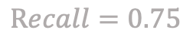
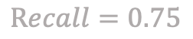
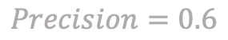
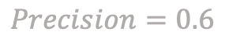
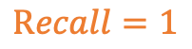
3.3.2 Precision / Recall Trade-Off
Predict to Negative
Predict to Positive
$$Precision=0.57$$
$$Precision=0.6$$
$$Recall=1$$
$$Recall=0.75$$
$$Precision=0.5$$
$$Precision=0.6$$
$$Recall=0.5$$
$$Recall=0.75$$
$$Precision=0.66$$
$$Precision=0.6$$
$$Recall=0.5$$
$$Recall=0.75$$

Slide 15
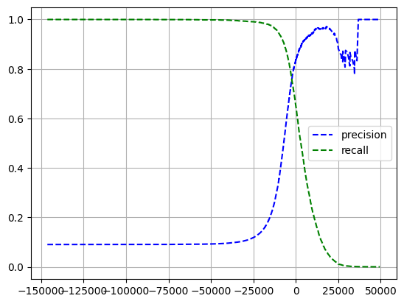
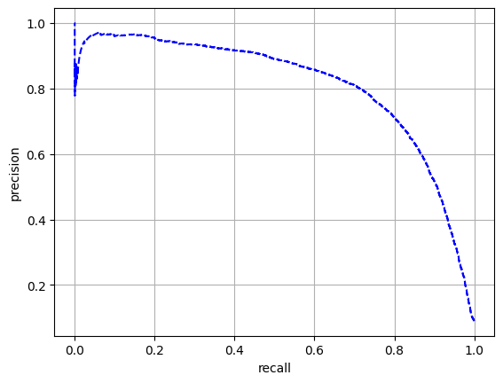
3.3.3 PR, ROC Curve
The precision curve can be uneven

Slide 16
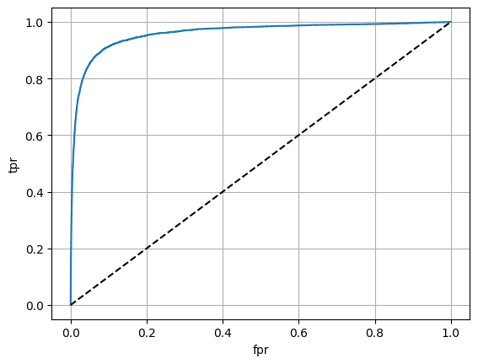
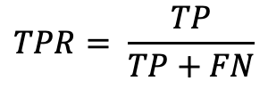
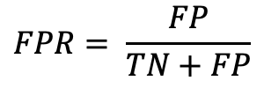
3.3.3 PR, ROC Curve
ROC Curve is relationship between TPR and FPR
$$TPR= \frac{TP}{TP+FN}$$
$$FPR= \frac{FP}{TN+FP}$$

Slide 17

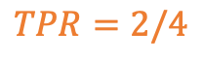

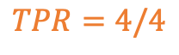
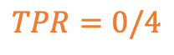


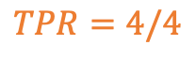
3.3.3 PR, ROC Curve
$$FPR=7/7$$
$$TPR=4/4$$
$$FPR=4/7$$
$$TPR=4/4$$
$$FPR=1/7$$
$$TPR=2/4$$
$$FPR=0/7$$
$$TPR=0/4$$

Slide 18
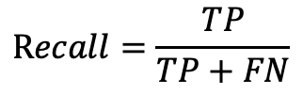
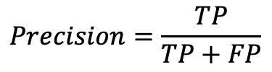
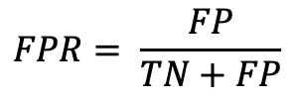
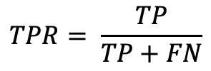
3.3.3 PR, ROC Curve
PR
ROC
$$Precision=\frac{TP}{TP+FP}$$
$$TPR= \frac{TP}{TP+FN}$$
$$Recall=\frac{TP}{TP+FN}$$
$$FPR= \frac{FP}{TN+FP}$$
more interested in TP
the percentage of negative-positive classes is similar
the percentage of negative-positive classes is different

Slide 19

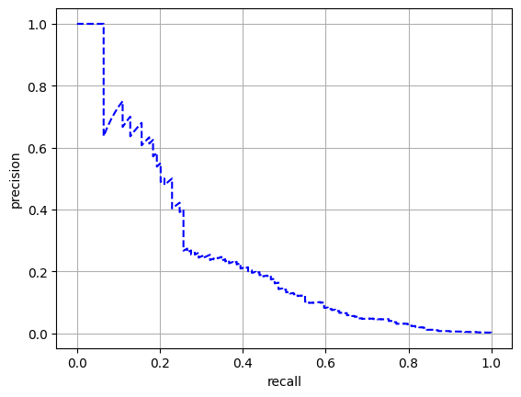

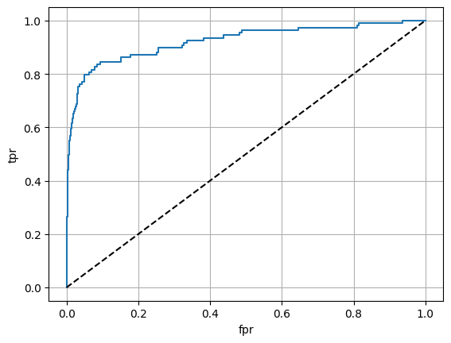
3.3.3 PR, ROC Curve
Positive rate = 1.0
Positive rate = 0.1
PR-Curve
ROC-Curve

Slide 20
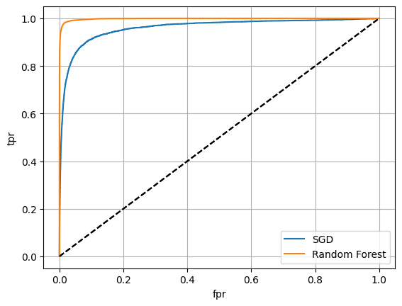
3.3.4 AUC

Slide 21
Thank You For Listening

